Slide 1
Genetic Algorithms Benchmark
Computational Intelligence 2023/2024
Luca Catalano – S308658
Claudio Savelli – S317680
Florentin-Cristian Udrea – S319029

Slide 2
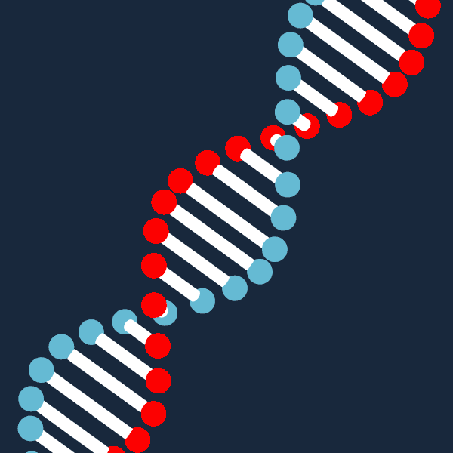
INTRODUCTION

Slide 3

Problem Introduction
Task
1
2
Objective
Optimizing the value of an unknown fitness function on an array of bits.
Minimizing the number of fitness calls.
Method to Use
3
4
Constraints
Genetic Algorithms. Search Heuristic inspired by the process of natural selection.
None if not exploiting the problem on the specific solution.

Slide 4



Introduction Overview
Parent Selection
Reproduce Functions
Mutations
How parents are selected at each generation.
How new genes are generated.
Random changes in the population.
Population Selection
Tricks
Tricks to minimize the number of fitness calls.
How the new population is selected for each generation.
Notes:
Random changes in the population to maintain genes diversity and to improve the exploration phase

Slide 5
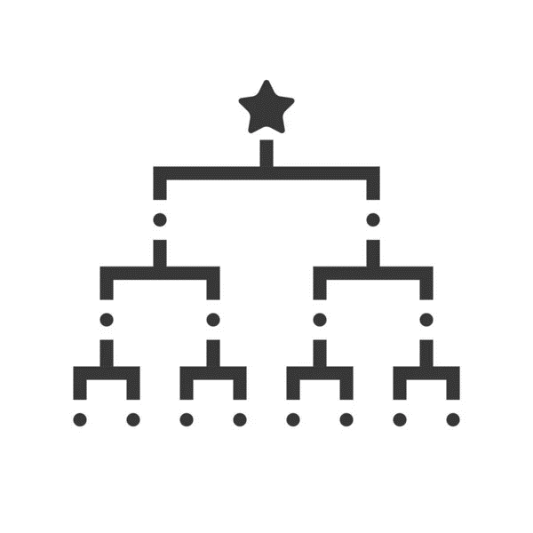

Parent Selection
Better with a lot of individuals
Better with few individuals
TOURNAMENT
ROULETTE
For each Generation, the parents are selected through tournaments where they compete based on their fitness.
Each portion of a roulette wheel is assigned to an individual in the population based on their fitness. Individuals with higher fitness have larger portions.
Notes:
Tournament Size is a parameter that influences the balance between exploration and exploitation, since at each iteration the participants of the tournament are randomly sampled from all the pool

Slide 6
Reproduce Function
Uniform
For each element, choose one of the parents and select the element in the same position.
One-Cut
A gene point is randomly selected. In a part, the gene of one of the two parents is copied, and in the second the other.
Two-Cuts
Same as One-Cut but two points are selected.

Slide 7
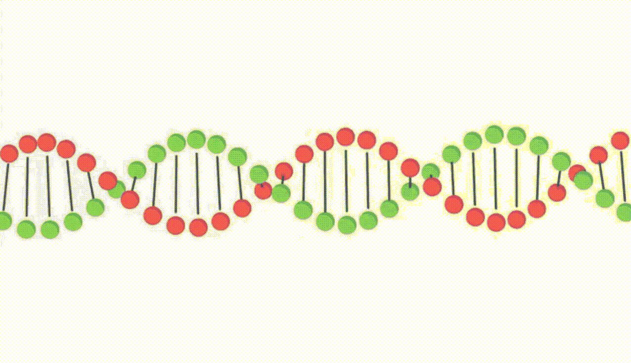
Mutation
01
ONE-BIT-FLIP
Randomly change one single bit.
02
THREE-BIT-FLIP
Randomly change three bits.
Notes:
Aumenta probabilità di mutazione se i genitori sono molto simili

Slide 8


Population Selection
Comma
Plus
Only children are selected for the following generation.
Parents are considered too in the selection.

Slide 9



Trick to minimize fitness calls
EARLY STOPPING
If nothing gets better for a while, stop simulation
DYNAMIC MUTATION
Individuals with similar parents have higher probability to mutate
MEMOIZATION
Individuals' fitness is stored and reused

Slide 10
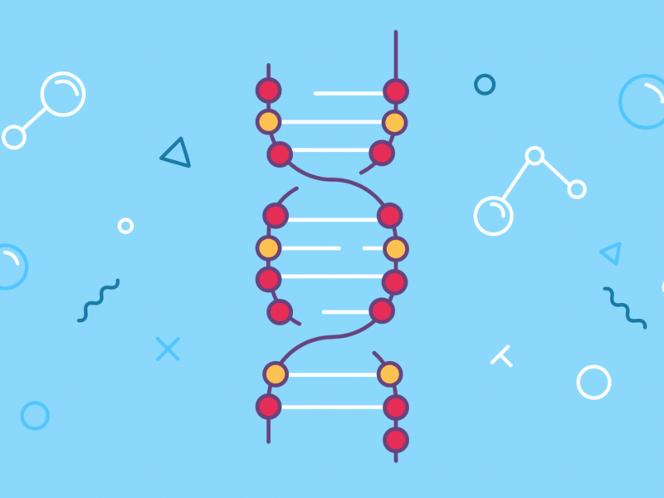
OUR SOLUTIONS

Slide 11

Baseline
We try all possible combinations of the methods.
We evaluate our results with 10 iterations on each experiments. We published the mean values.
Hyperparameter:
MU = 15
LAMBDA = 30
MUTATION_PROB = 0.2
DYNAMIC_MUTATION_PROB = True
LENGTH_SOLUTION = 1_000
NUMBER_GENERATIONS = 3_000
COOLDOWN_TIME = 100

Slide 12


Slide 13

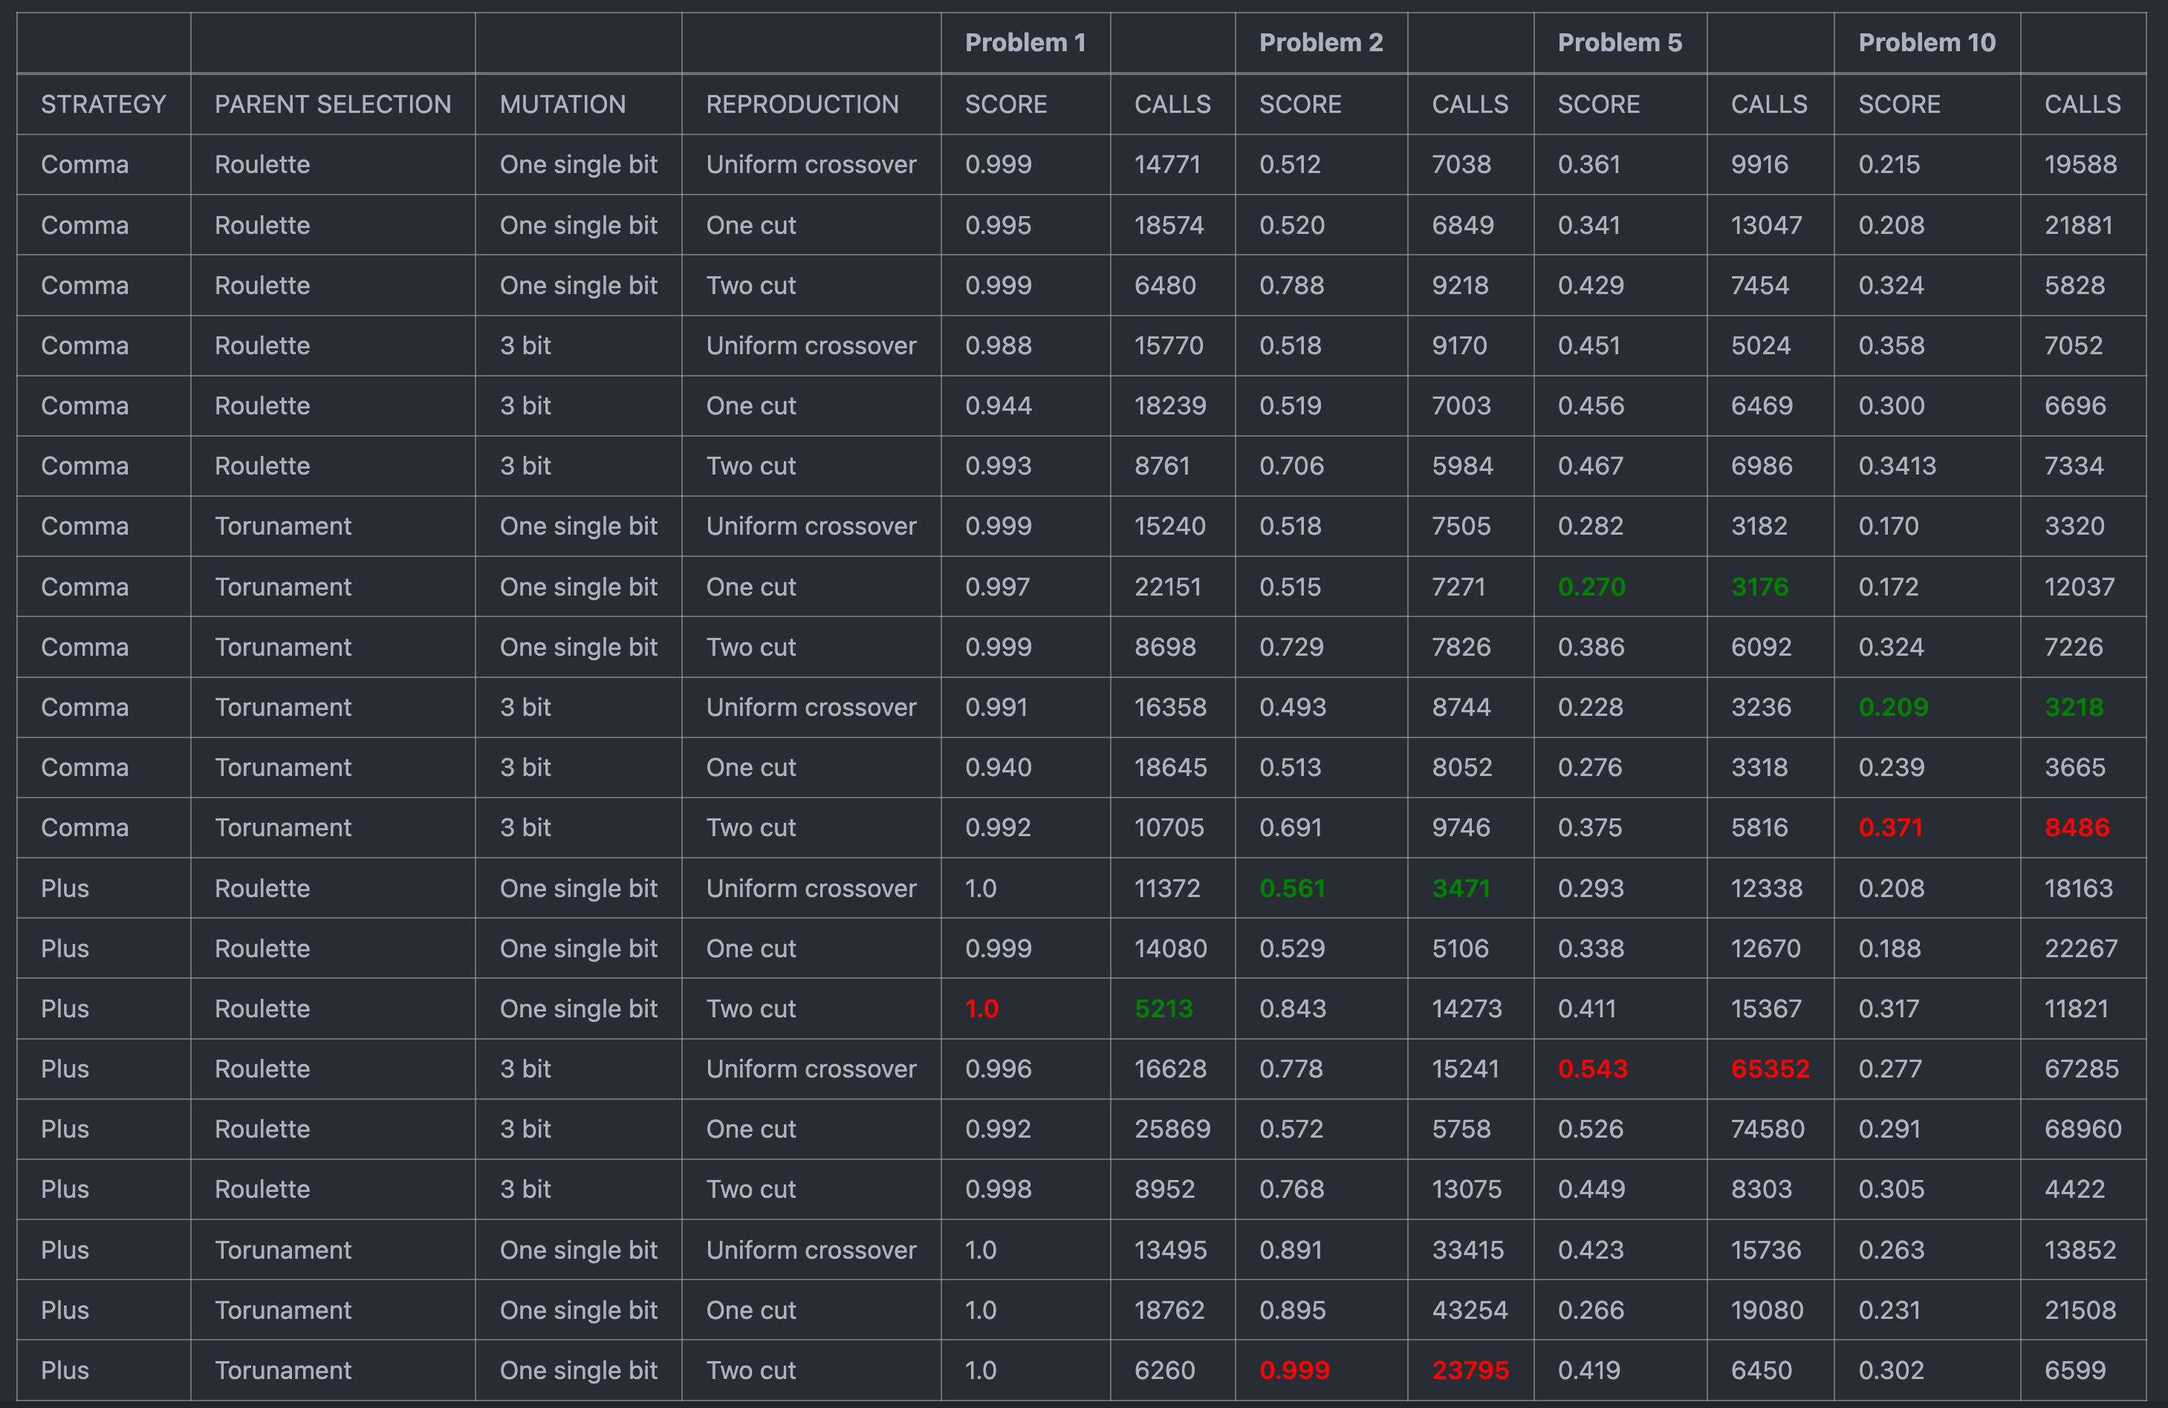

Baseline
more than 1000 tests

Slide 14

Analysis
Given that each generation has a low mu (number of parents), as expected, the Roulette method seems to work better than the Tournament method.
While dynamically selecting which offspring to mutate, in general applying the same mutation throughout the genetic algorithm results in the mutation going better on a single-bit (more exploitative) than on three-bits (more explorative).
Generally, Two-Cuts reproduction gave better results in all problems.
Generally, the ‘Plus’ strategy achieves higher fitness values, while ‘Comma’ achieves convergence in fewer fitness calls.
We will use this highlighted configuration for the next experiments

Slide 15

Baseline – Best results
Problem 1 |  | Problem 2
Score | Calls | Score | Calls
1.0 | 5’213 | 0.999 | 23’795
Plus, Roulette,1 single-bit, Two-cuts |  | Plus, Tournament, 1 single bit, Two-cuts
Problem 5 |  | Problem 10
Score | Calls | Score | Calls
0.543 | 65’352 | 0.371 | 8’486
Plus, Roulette, 3-bits, Uniform |  | Comma, Tournament, 3-bits, Two-cuts

Slide 16
Islands
Islands Model refers to partitioning the population into subgroups (islands) that evolve separately.
Periodic migration or exchange of individuals between islands fosters diversity and information exchange.

Slide 17
Islands
What is the process for migrating individuals?
Radom migration
Ring topology migration
Fitness based
At what point should individuals be migrated?
Fixed generation
Fitness based

Slide 18
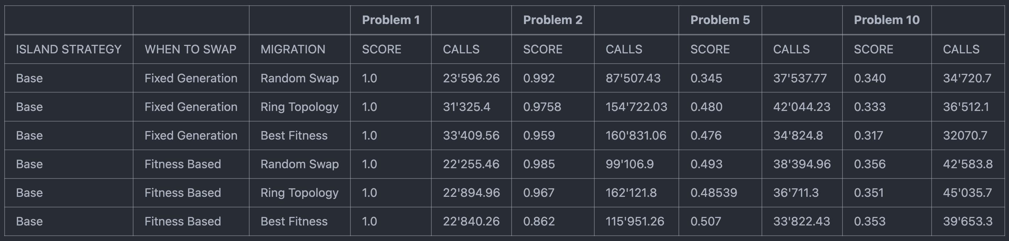
Islands

Slide 19
Analysis
Island methods ask for more fitness evaluations, but yield better results in general
Island method is more robust and results have less variance between runs
Fitness based outperforms fixed generation
There is not much difference between migration strategies. We choose Random Swap for the next experiment
We will use this highlighted configuration for the next experiments

Slide 20
Islands: results
Problem 1 |  | Problem 2
Score | Calls | Score | Calls
1.0 | 22’225 | 0.992 | 87’507
Random Swap, Fitness based |  | Random Swap, Fixed Generation
Problem 5 |  | Problem 10
Score | Calls | Score | Calls
0.507 | 33’822 | 0.356 | 42’583
Best Fitness, Fitness based |  | Random Swap, Fitness based

Slide 21
Valhalla + Islands
Partition of the population into subgroups (islands) that evolve separately.
Valhalla method prioritizes the preservation of elite individuals, the best-performing solutions, from each generation and from each island and they are protected from alteration or modification.

Slide 22
Valhalla + Islands
When Valhalla exceed maximum capacity, it migrates randomly some of his individuals in the islands.

Slide 23
Valhalla + Islands: results
Problem 1 |  | Problem 2
Score | Calls | Score | Calls
1.0 | 27’052 | 0.997 | 107’739
Problem 5 |  | Problem 10
Score | Calls | Score | Calls
0.495 | 30’052 | 0.345 | 34’369

Slide 24
Islands Segregation
Multiple subpopulations (islands) evolve independently for a certain number of generations before occasionally exchanging information.
The islands most similar in fitness are combined into a single island.
When?
Fitness changes are less or equal to a given threshold.
The number of generation is greater or equal a given threshold.

Slide 25
Islands Segregation: results
Problem 1 |  | Problem 2
Score | Calls | Score | Calls
1.0 | 22’941 | 0.989 | 100'672
Problem 5 |  | Problem 10
Score | Calls | Score | Calls
0.527 | 65’083 | 0.375 | 62’032

Slide 26
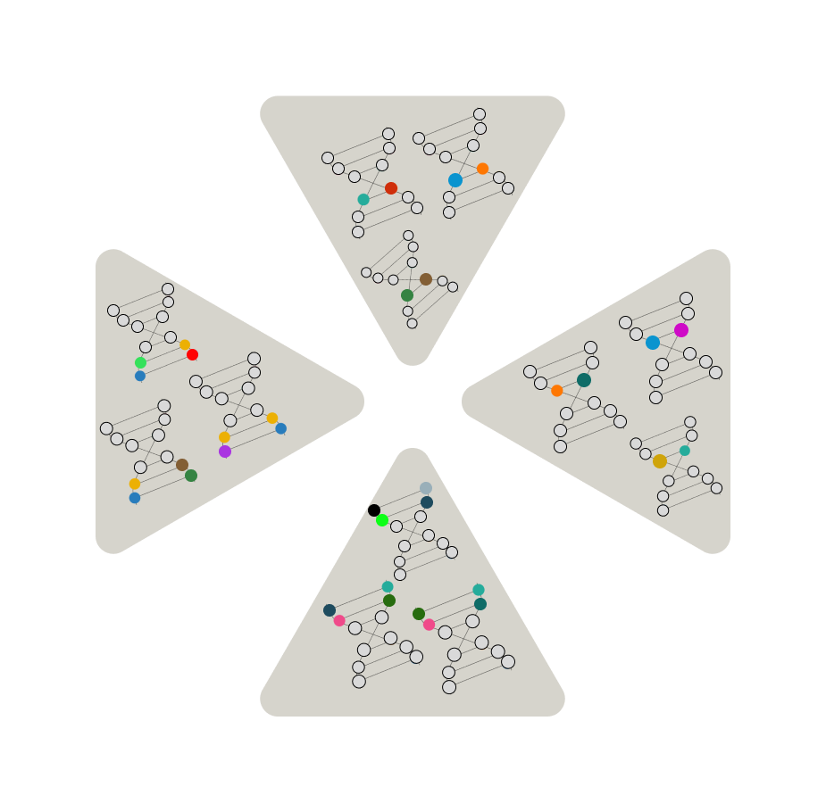
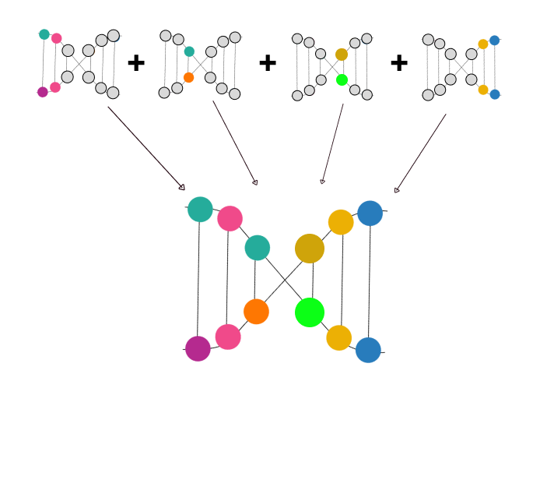
Expert Islands
Each island is formed by individuals of smaller size than the actual solution needed
The islands do not communicate in this scenario
The island optimizes individuals that are used as subpart of the solution
Each individual has size SOLUTION_SIZE/NUM_ISLANDS
The solution is represented by the concatenation of the best agents of each island

Slide 27
Expert Islands: results
Problem 1 |  | Problem 2
Score | Calls | Score | Calls
0.612 | 17’592 | 0.589 | 33’882
Problem 5 |  | Problem 10
Score | Calls | Score | Calls
0.453 | 36’734 | 0.326 | 28’360

Slide 28
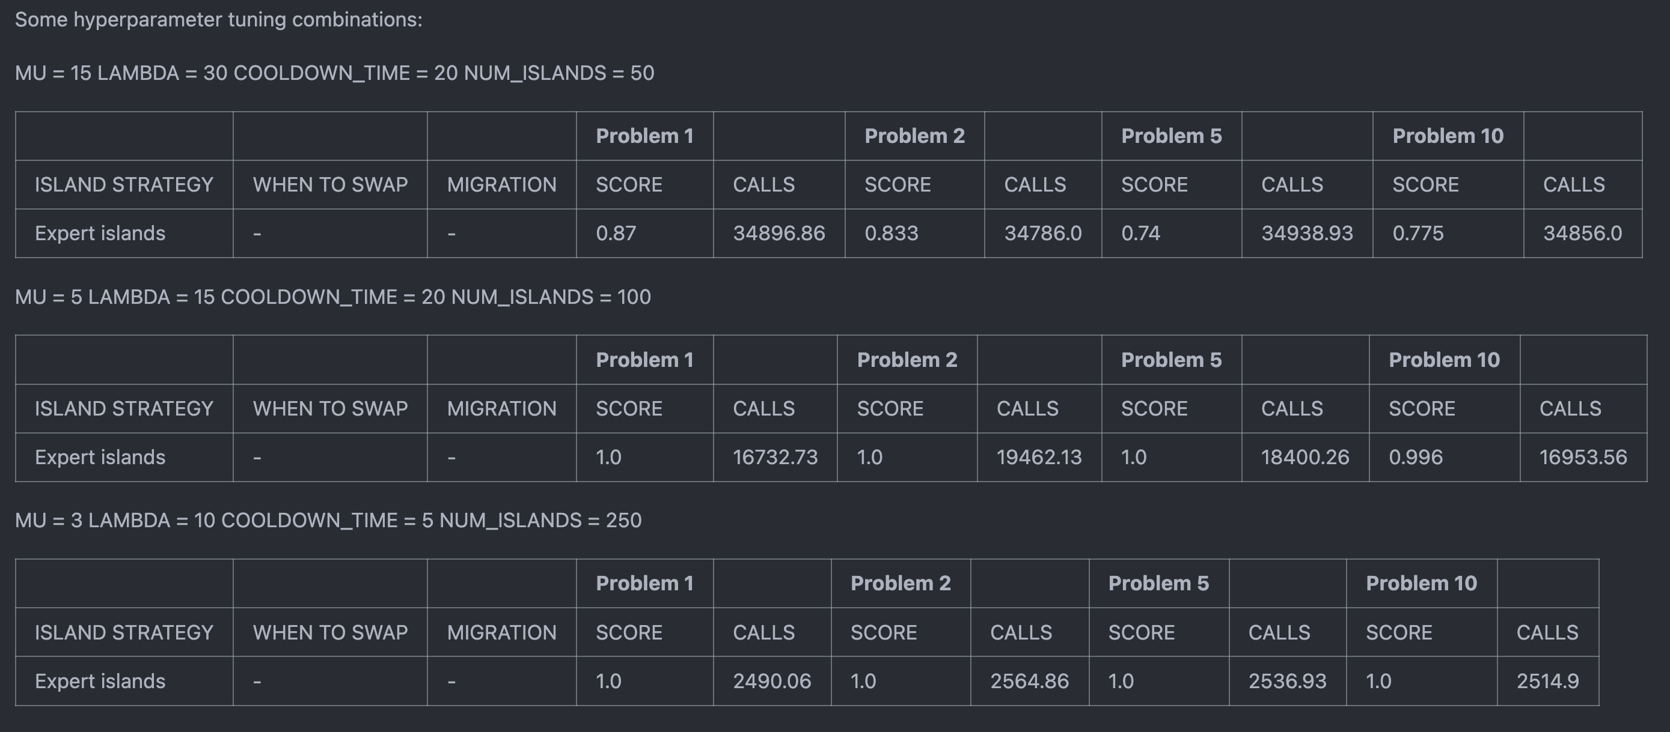

Hyperparameters Optimization

Slide 29
Expert Islands: results
MU = 3 - LAMBDA = 10 - COOLDOWN_TIME = 5 - NUM_ISLANDS = 250
Problem 1 |  | Problem 2
Score | Calls | Score | Calls
1.0 | 2’490 | 1.0 | 2’564
Problem 5 |  | Problem 10
Score | Calls | Score | Calls
1.0 | 2’536 | 1.0 | 2’514

Slide 30

Neural Network to evaluate fitness
IDEA
To minimize the number of calls to the fitness function, it might be useful to find a method of proxying the function!

Slide 31
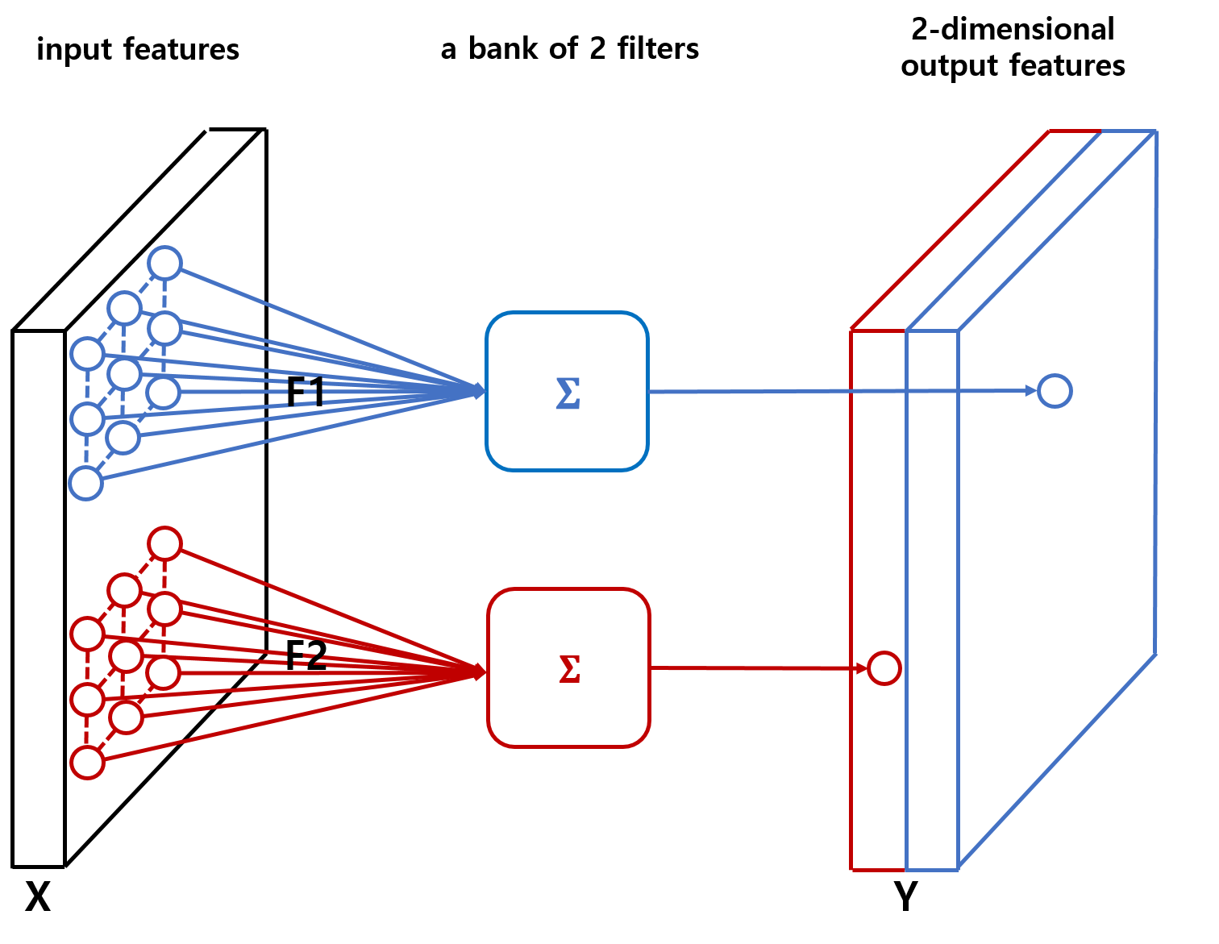
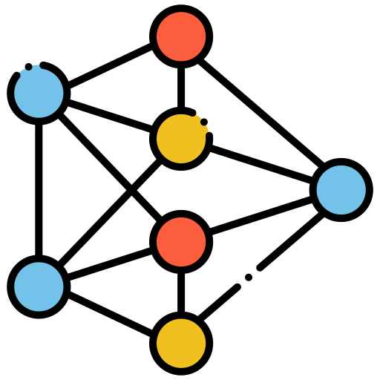
Neural Network to evaluate fitness
STRUCTURE
Various neural network configurations were tested. The one that gave the most satisfactory results was the one consisting only of a simple convolutional layer + fully connected layer.
Spatial awareness thanks to the Convolutional Layer!

Slide 32
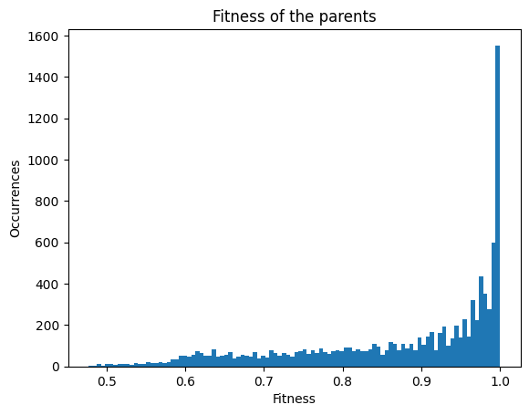

Neural Network to evaluate fitness
PROBLEMS
During the genetic algorithm, the distribution of data to train our model is strongly unbalanced. Furthermore, it is difficult for the model to evaluate genes that have a higher fitness than that obtained during the training phase.

Slide 33
What’s next
Test on new problems
Test the developed benchmark on new problems, to see if it is indeed applicable to other similar problems.
Extend the Benchmark
Due to time constraints, it was not possible to implement many other methods, parent selections, reproductions, or mutations. It might be interesting to extend the benchmark!
Formalize the Benchmark
Formalize the functions and methods used, with a more explanatory README on how each part of the code works, to turn the resulting benchmark into a library open to all!
Train the neural network several times during the genetic algorithm, once the imbalance problem has been solved, avoiding most of the exploitation phase calls.
Improve NN in the loop

Slide 34




Thank you!
Luca Catalano – S308658
Claudio Savelli – S317680
Florentin-Cristian Udrea – S319029

